Slide 1
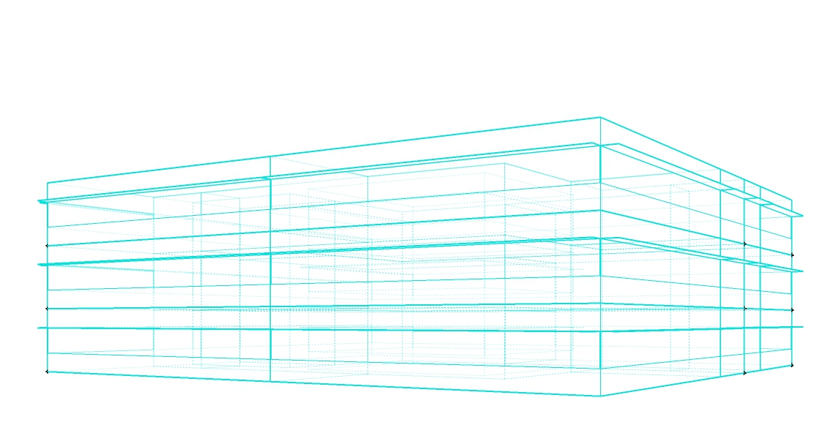
PROJECT RELATION
TECHNICAL ENVIRONMENTAL SYSTEMS
Prof. Renzo Marchesi
Group member:
Zhang Qilu
You Han

Slide 2
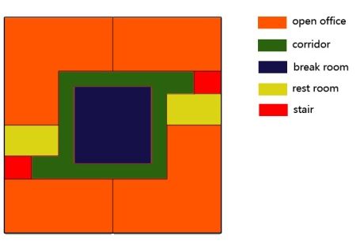
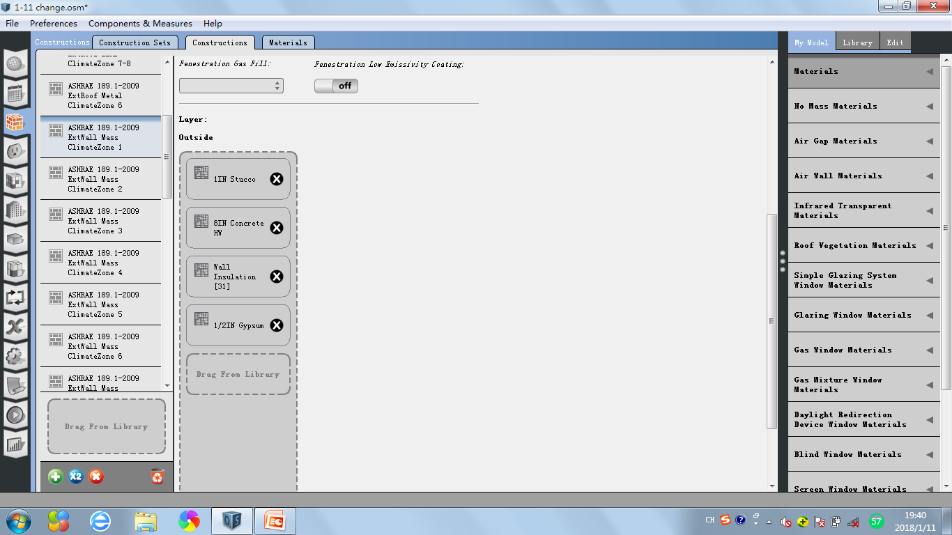
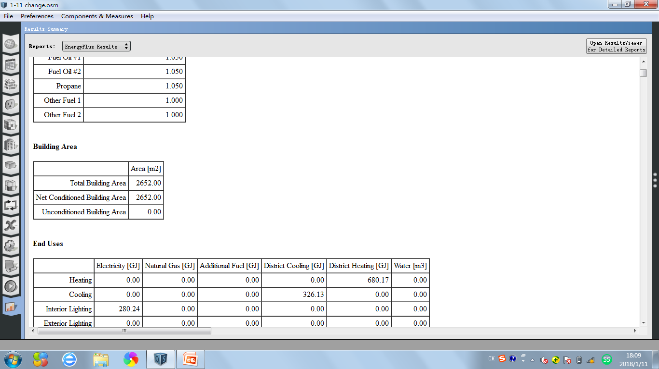
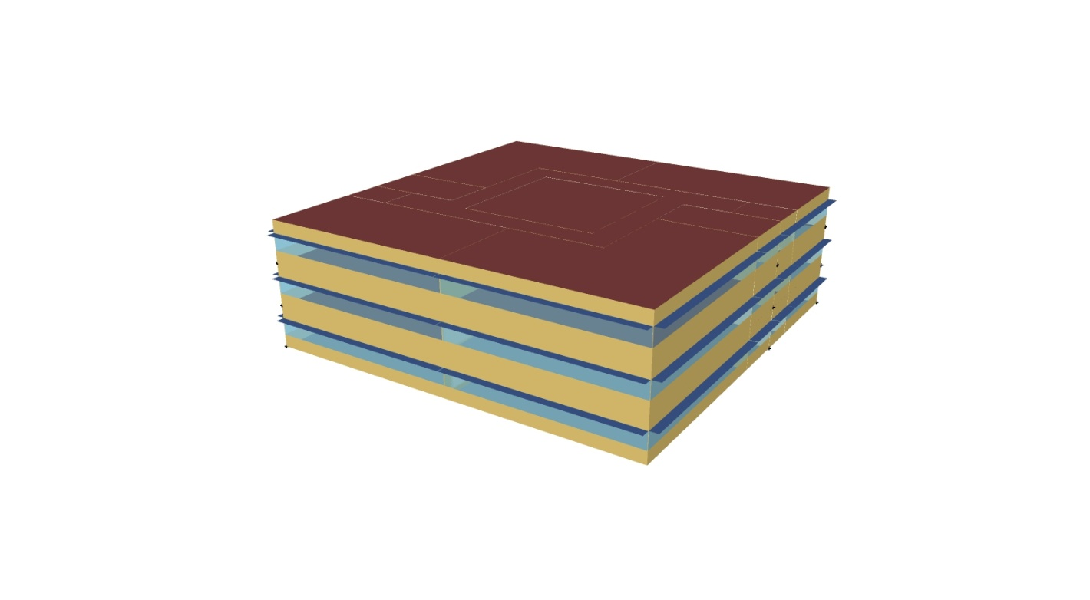
INTRODUCTION
Our project is a small office building which consists in the analysis of the energetic requirement of a building. The building we took into consideration is located in Piacenza and it has three layers with 28m * 28m of each. The total building area is 2652 ㎡.
The construction is made of concrete; the exterior wall is composed by:
·25.3mm Stucco
·203.3mm Concrete HW
·33.7mm wall Insulation
·12.7mm Gypsum
The goal of the exercise is to evaluate the energy performance of the building.
After this the building has been moved in another city with very different thickness of the exterior wall compared to the first one to see how the result would have changed.

Slide 3
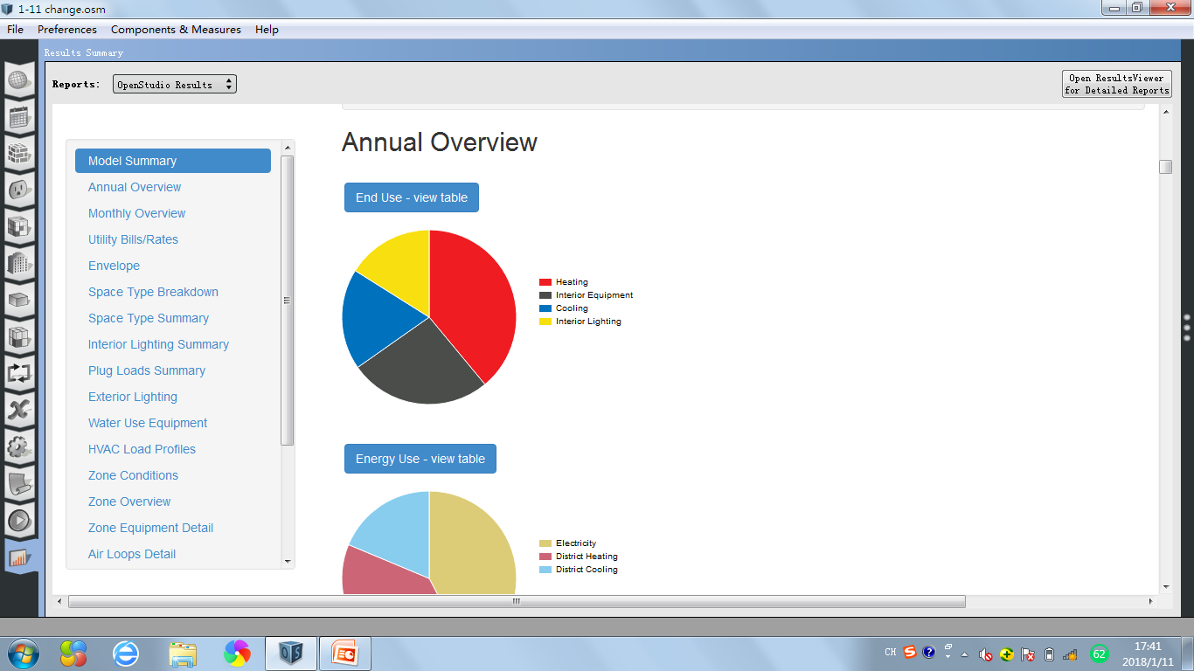
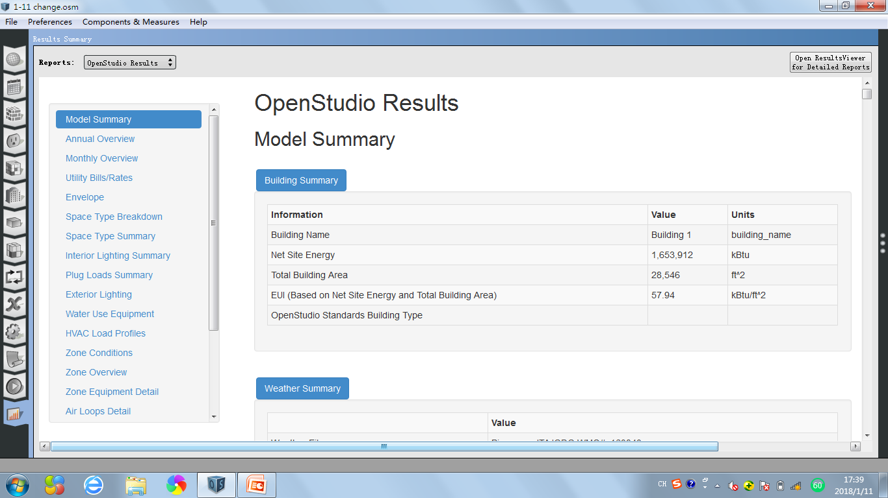
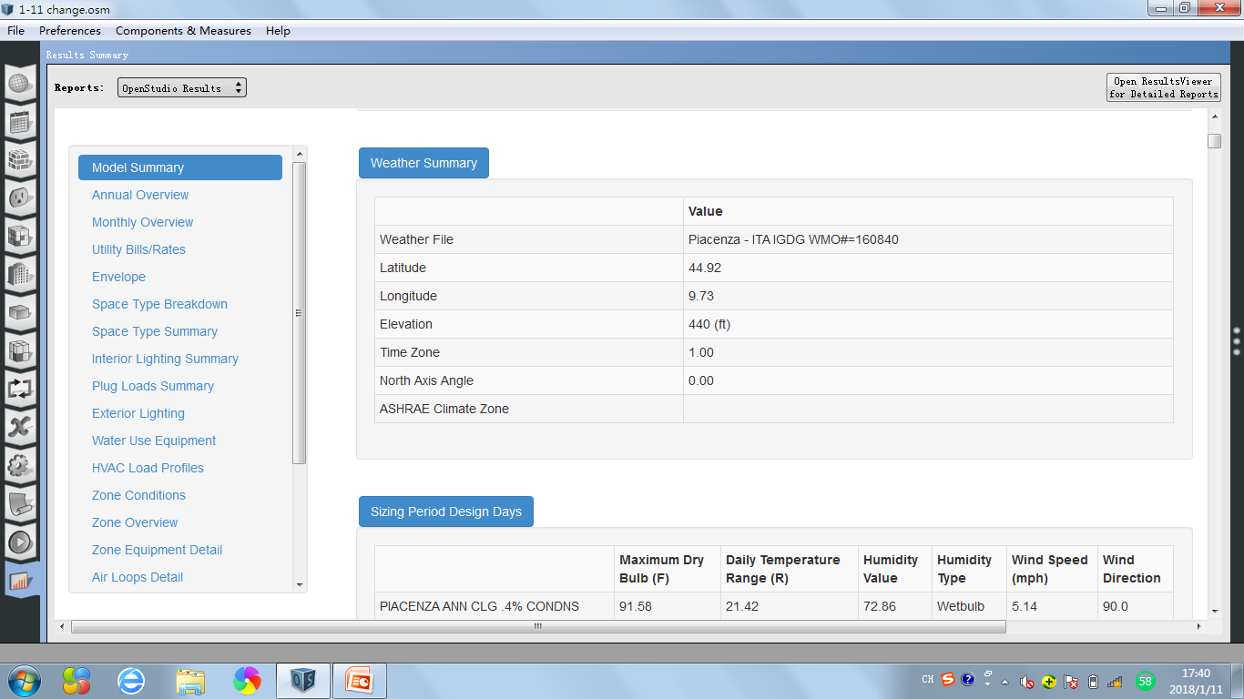
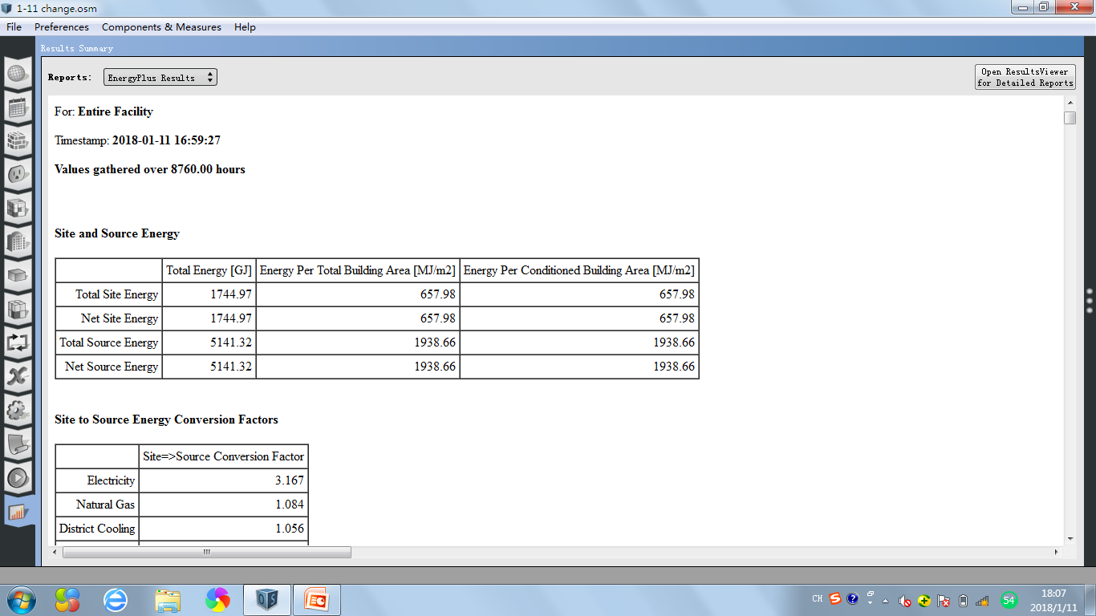
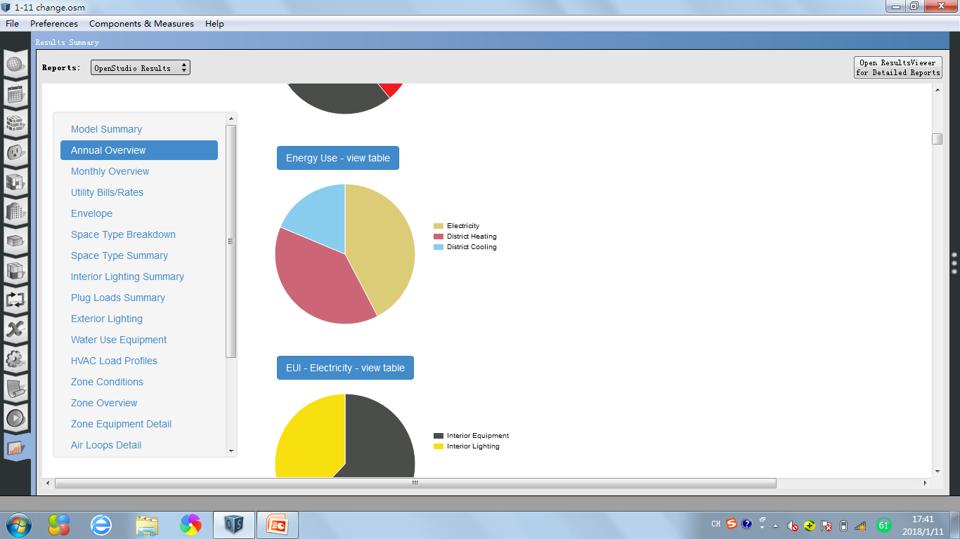
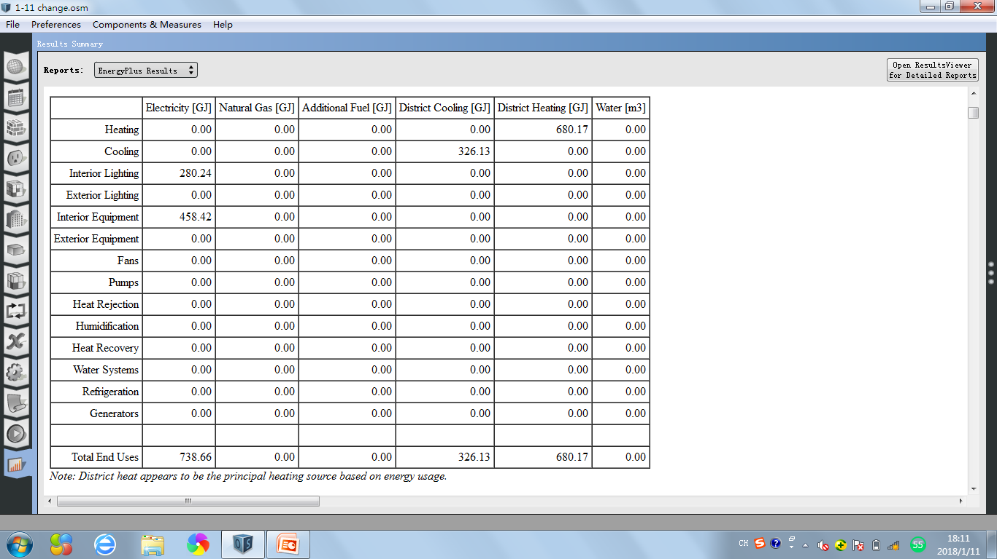
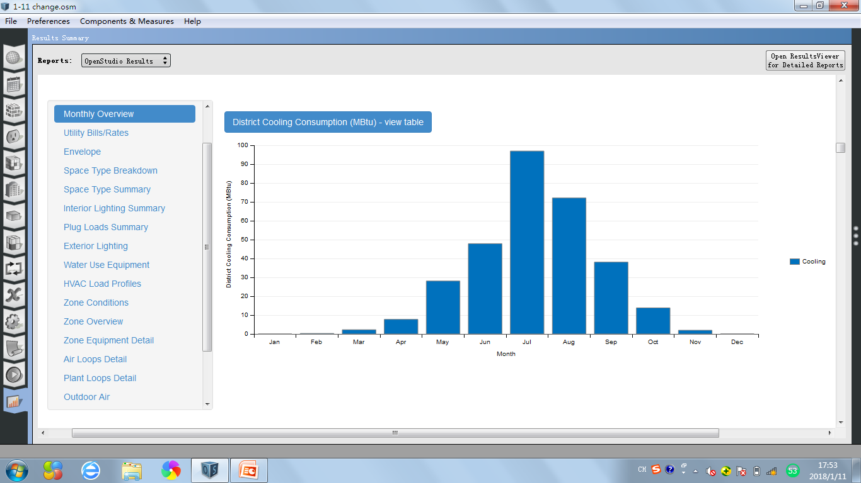
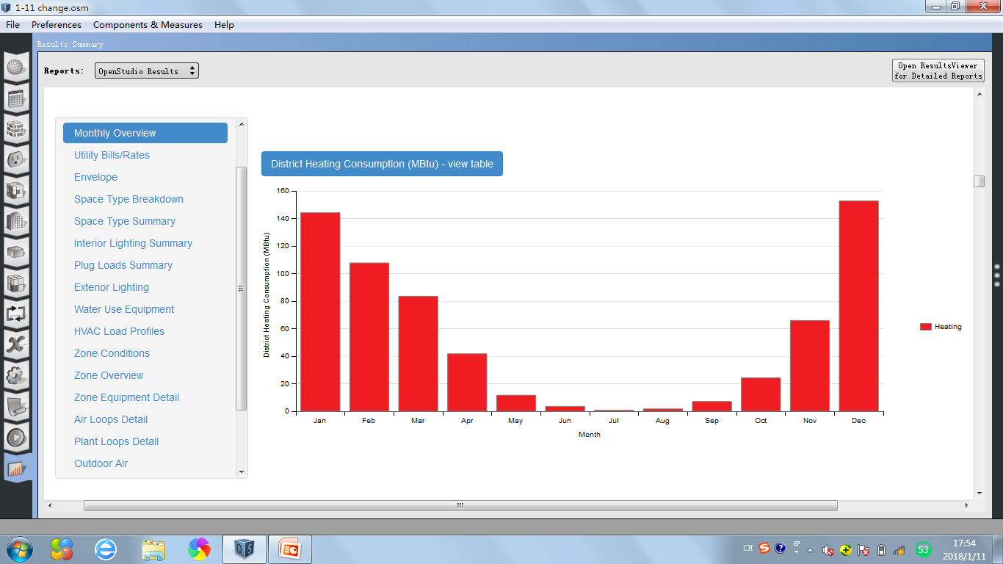
ANALYSIS
Once inserted the data in the program of calculation “Open Studio”, we went on analyzing.
Piacenza-Italy
266k
16%
645k
39%
309k
19%
434k
26%
309k
19%
The total energy of the building with wall insulation [31] in Piacenza is 1744.97GJ. The energy use for heating is 680.17GJ,which take the percentage of 39% in total energy, and 19% energy is used for cooling, 42% energy is used for electricity.
700k
42%
645k
39%
97
144
153
72
108
48
84
38
66
28
42
8
14
12
7
24
0
0
2
2
0
4
1
2
In this bar-table, we can see that the value of the energy use for cooling increases from January to July, then starts to decrease in August, which means there is a peak in July with the value of 97 MBtu.
In this bar-table, we can see that the value of the energy use for heating decreases from January to July, then starts to increase from August, which means the energy which is used for heating has a highest value(153MBtu) in December and lowest in July(1MBtu).

Slide 4
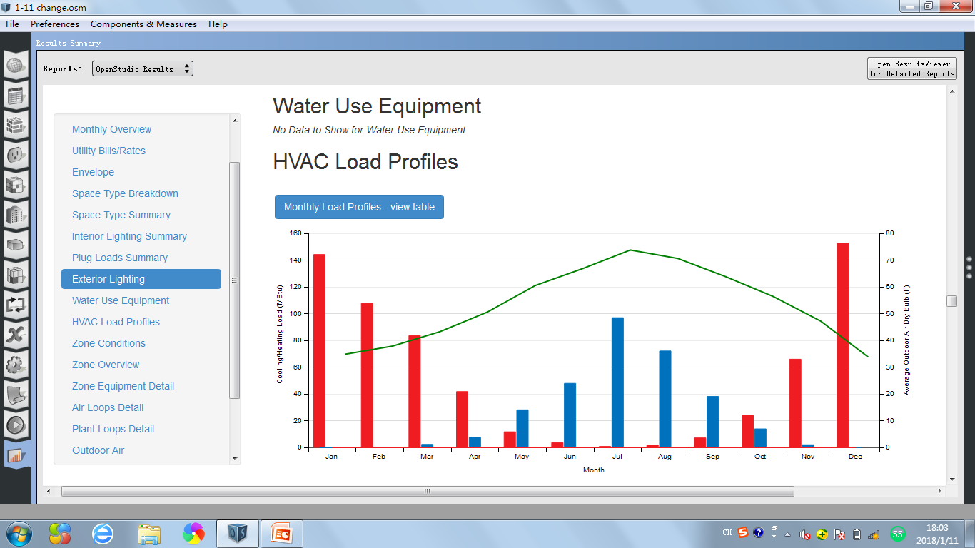
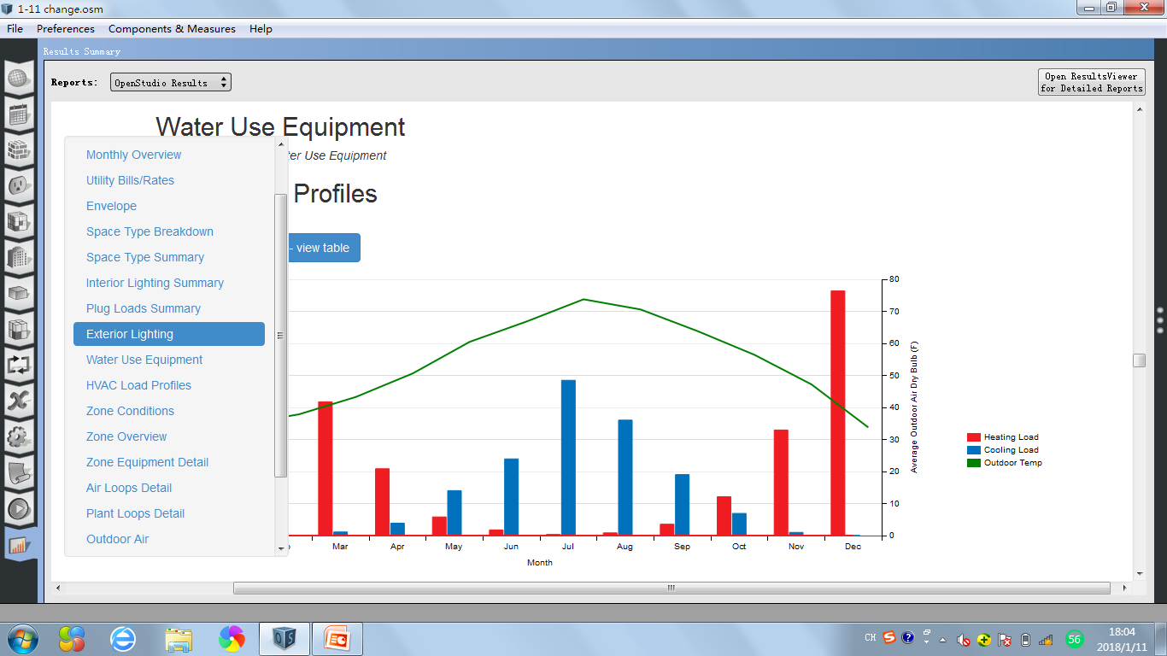
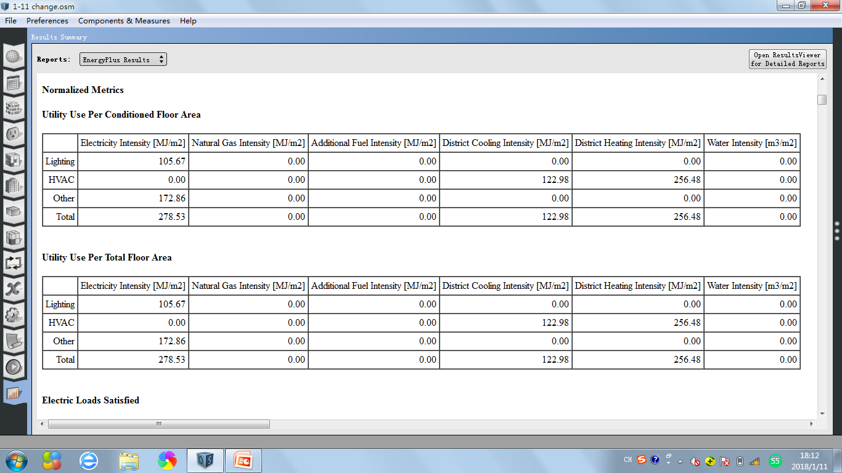
74
153
144
108
97
84
72
66
35
34
43
48
38
28
24
8
12
7
14
0
0
2
4
1
2
2
0

Slide 5
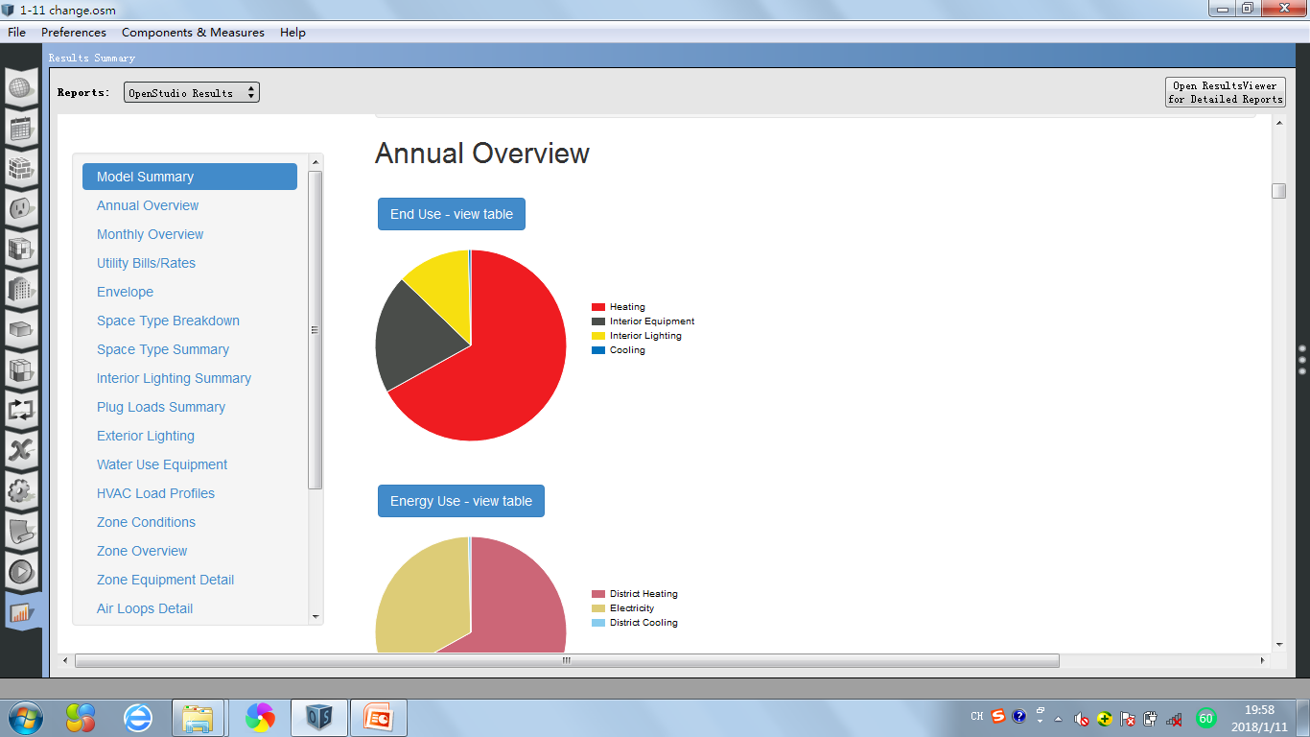
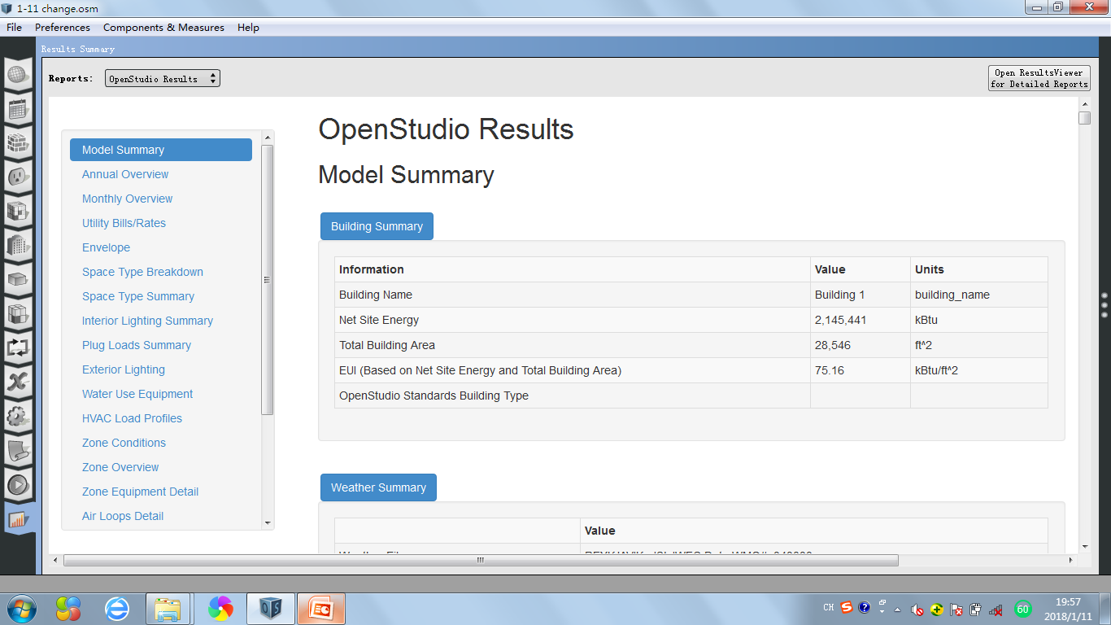
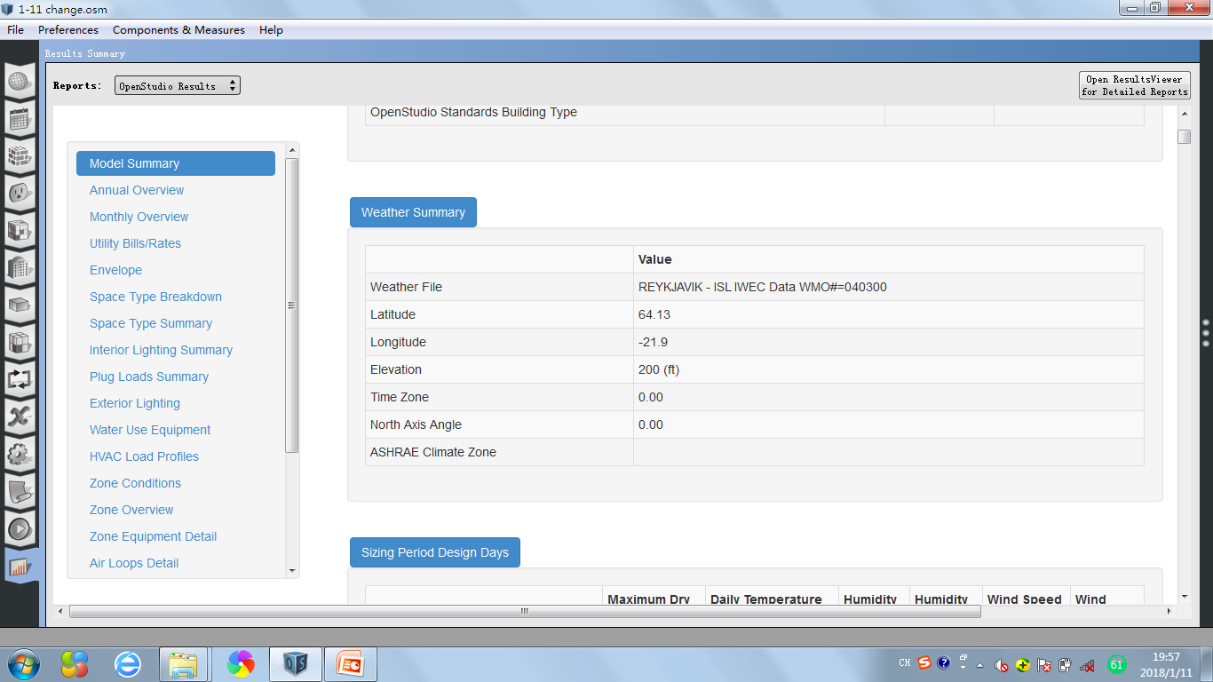
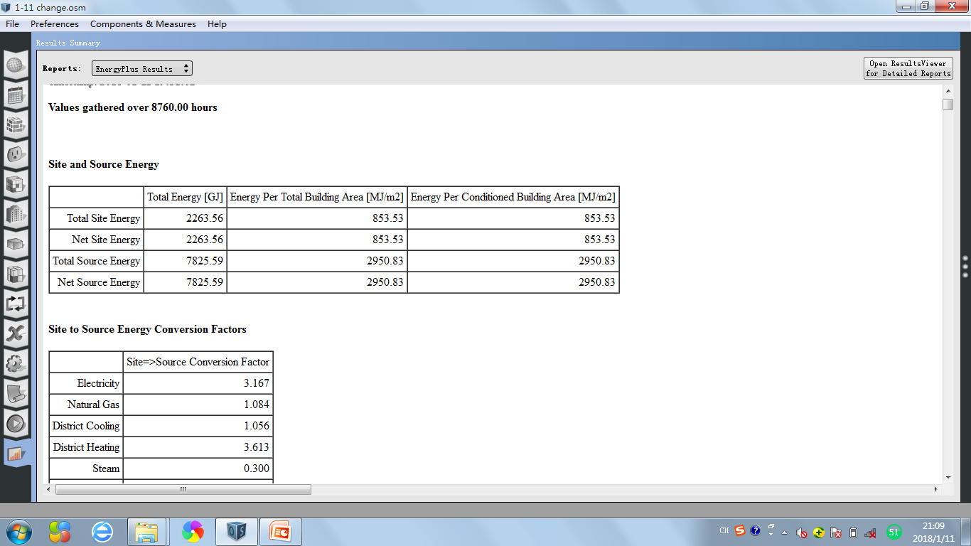
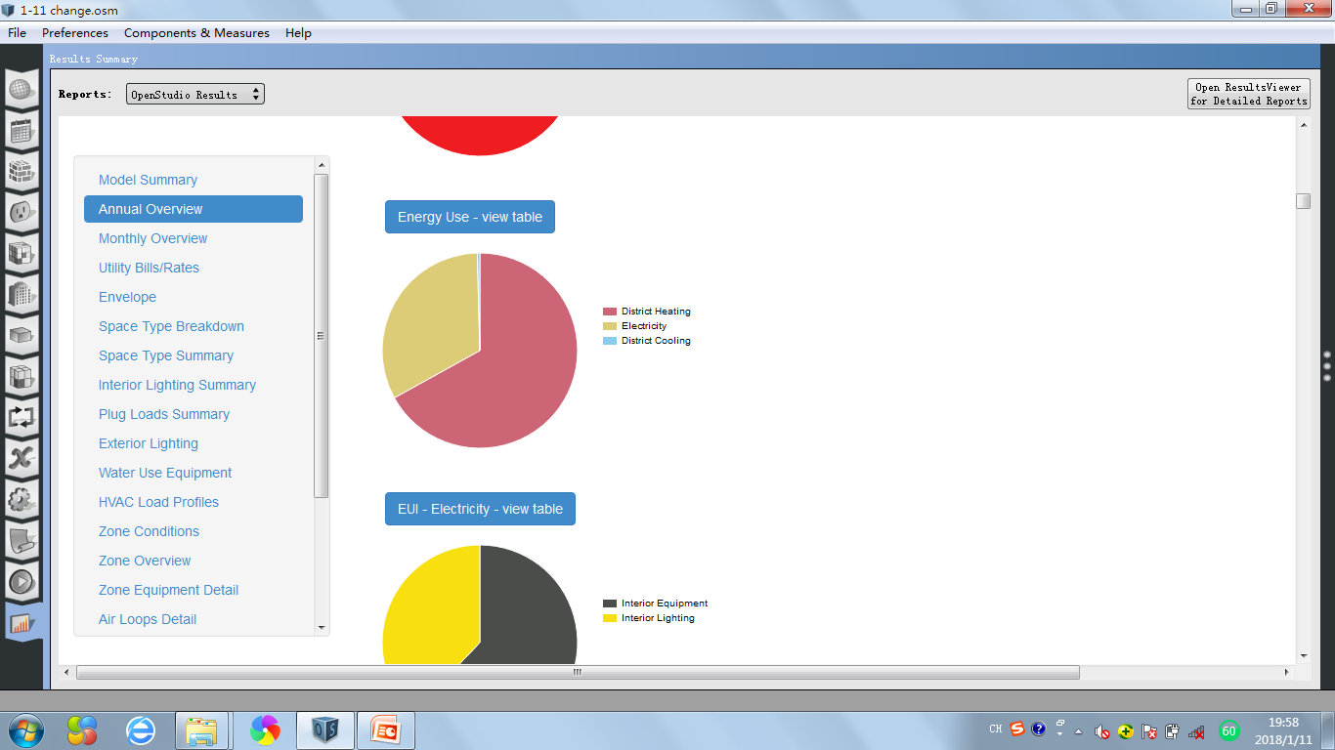
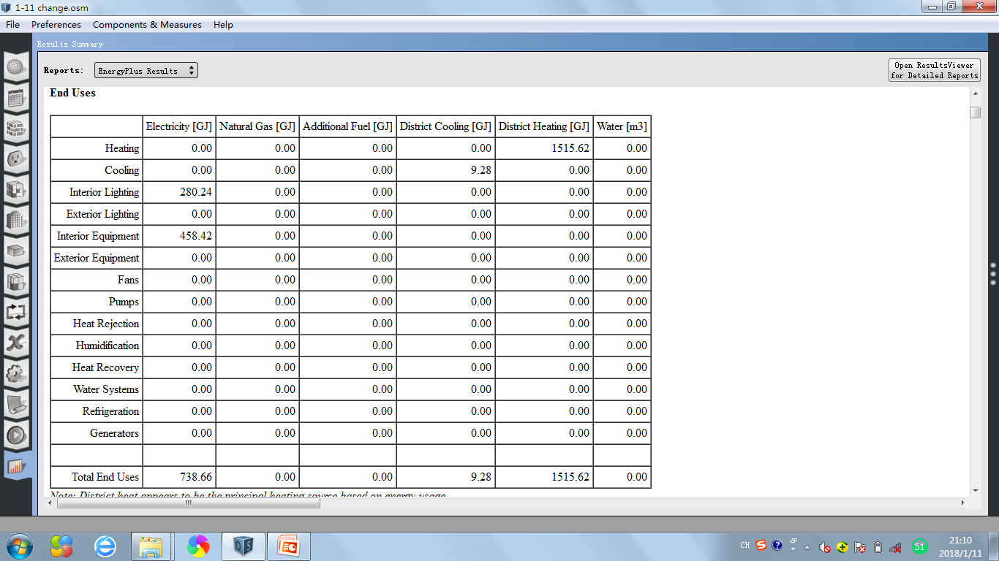
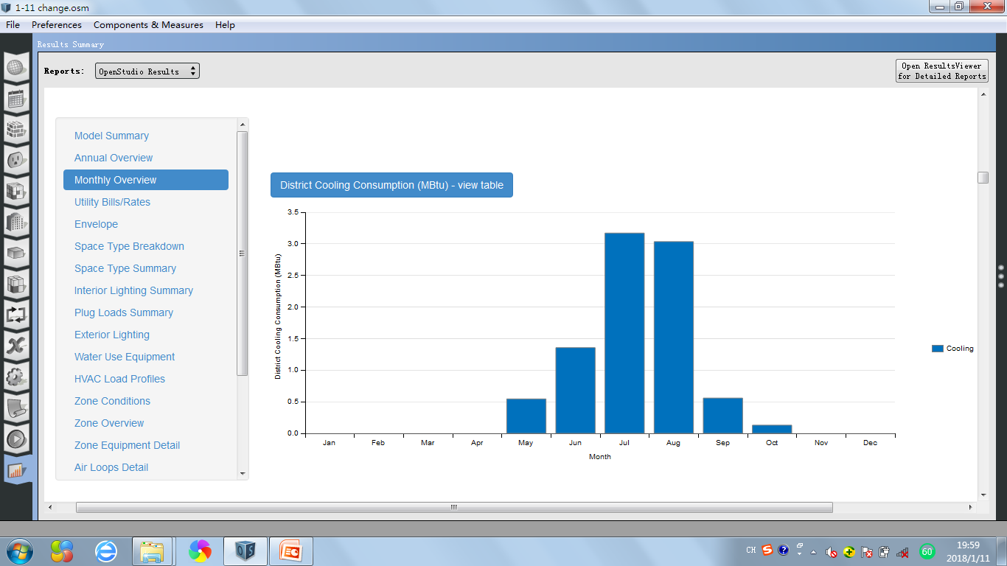
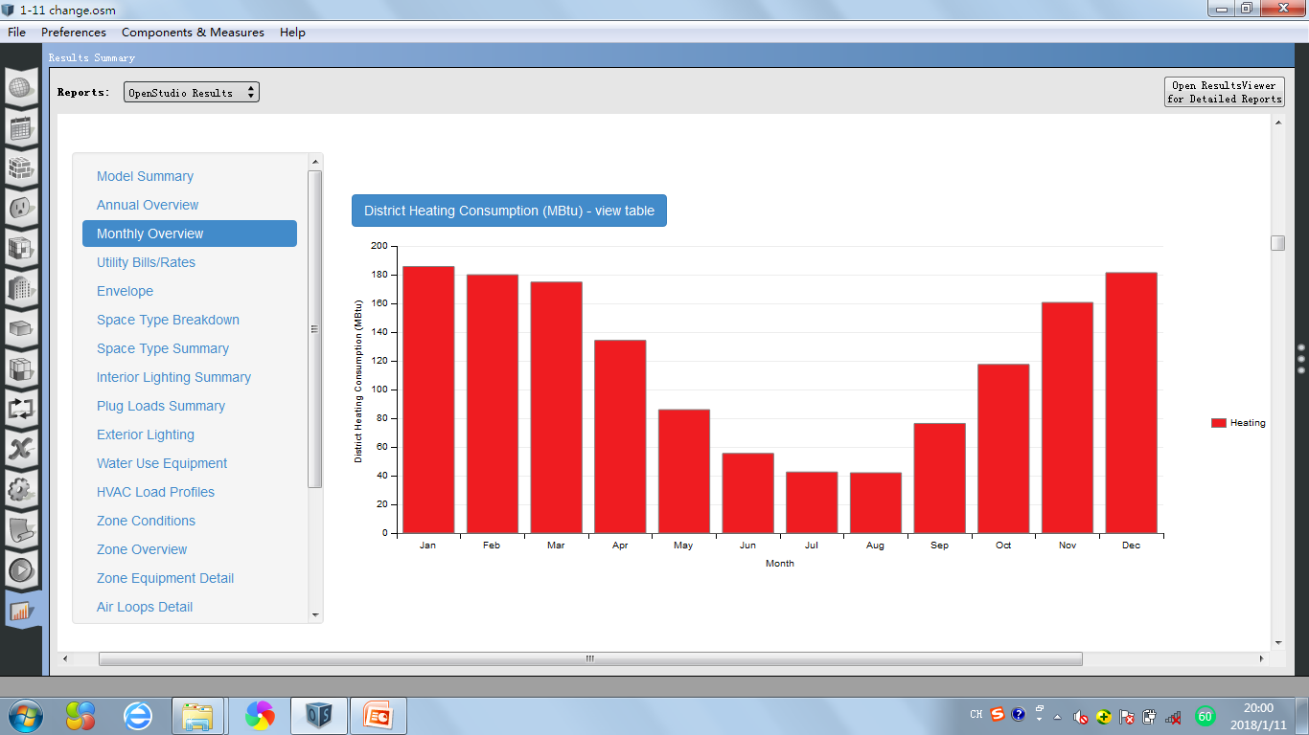
Reykjavik-Iceland
0.3m
12%
0.4m
20%
1.4m
67%
The total energy of the building with wall insulation [31] in Reykjavik, Iceland is 2263.56GJ. The energy use for heating is 1515.62GJ,which take the percentage of 67% in total energy, and only less than 1% energy is used for cooling(9.28GJ), 33% energy is used for electricity.
0.7m
33%
1.4m
67%
3.2
3.0
186
180
175
181
161
134
117
1.4
86
76
55
43
42
0.5
0.6
0.1
The table shows that the energy is only used from May to October with low value. The peak appears in July with 3.2MBtu value .
In this bar-table, we can see that the value of the energy use for heating exists all the yaer,which decreases from January to July, then starts to increase from August, which means the energy which is used for heating has a highest value(186MBtu) in January and lowest in August(42MBtu).

Slide 6
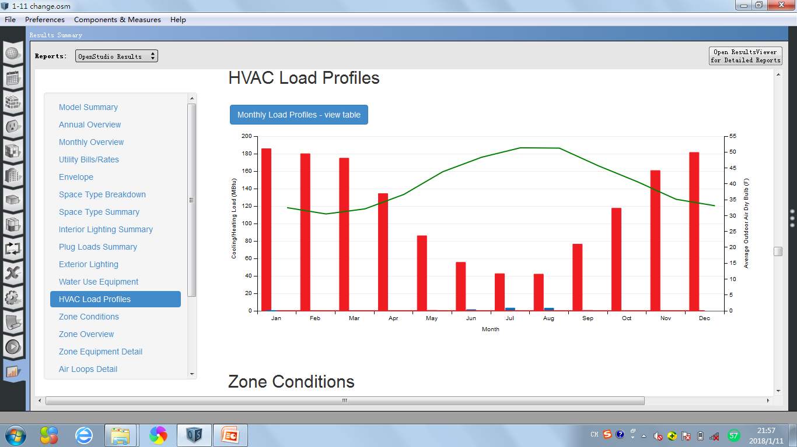
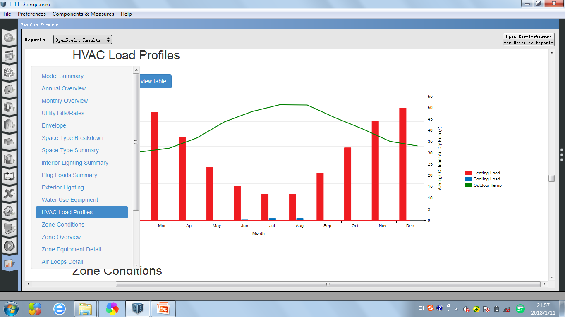
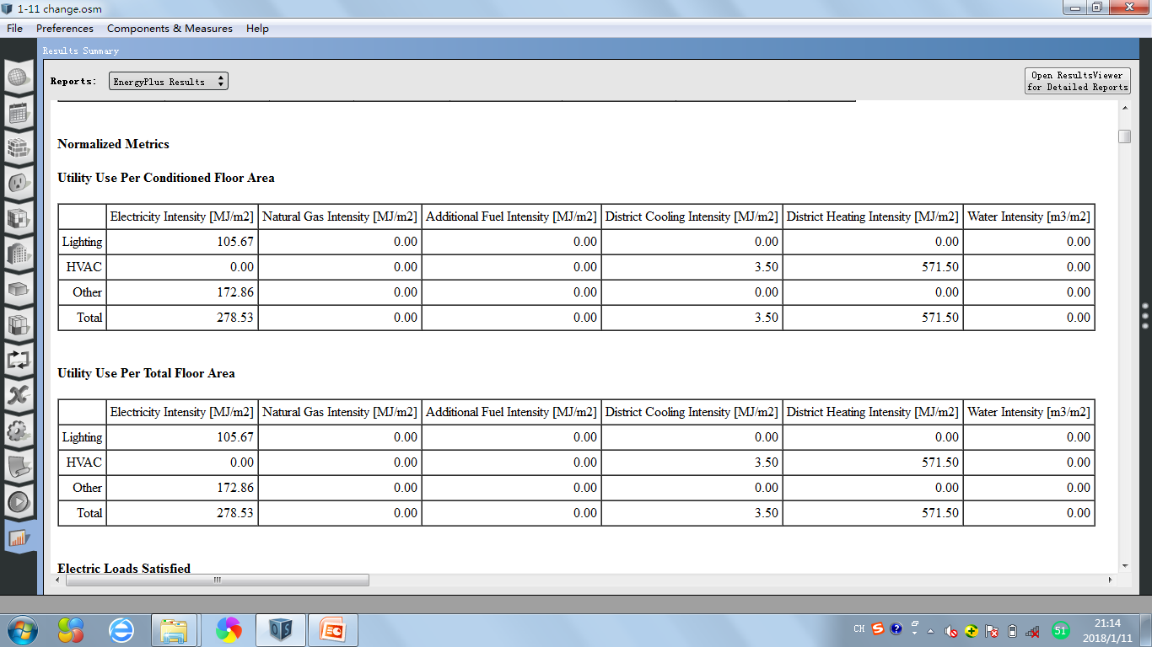
186
180
51
181
175
161
134
37
32
117
31
33
86
76
55
43
42
3
3

Slide 7
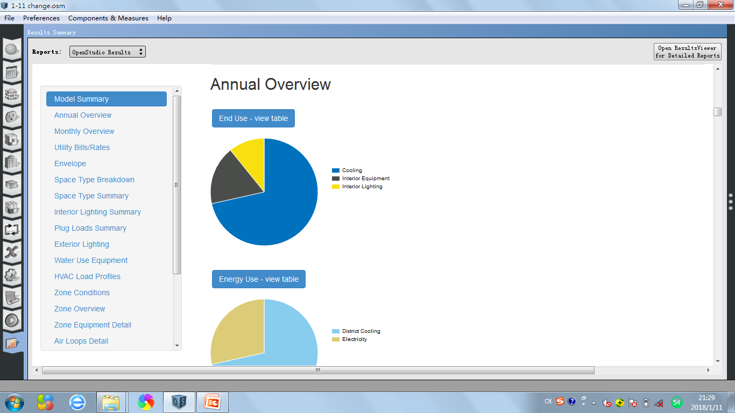
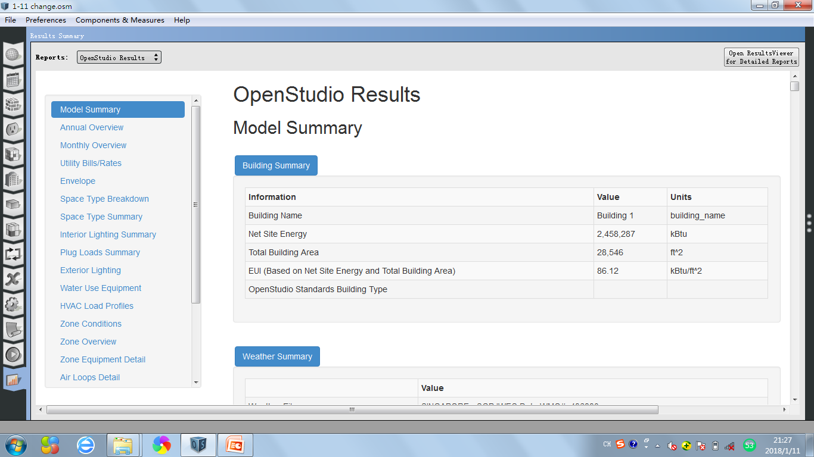
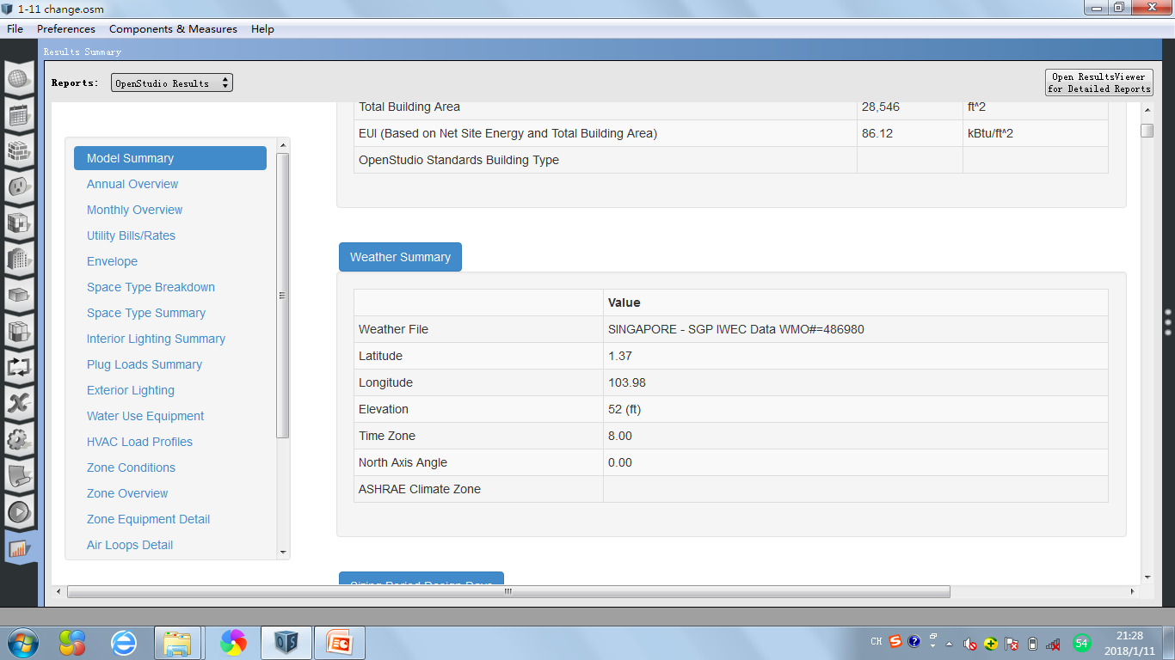
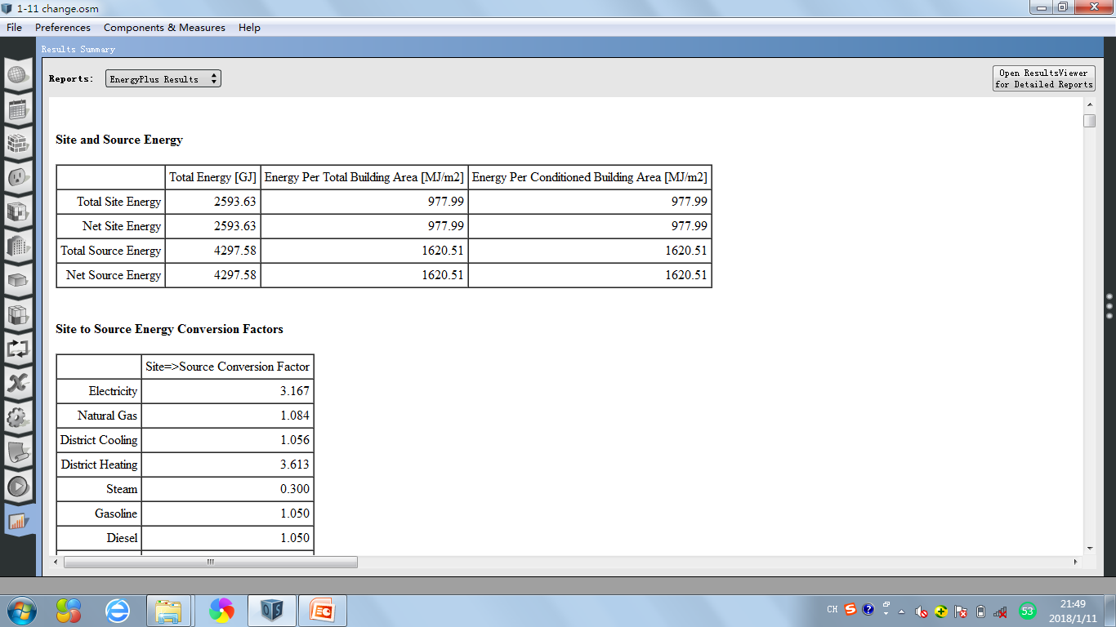

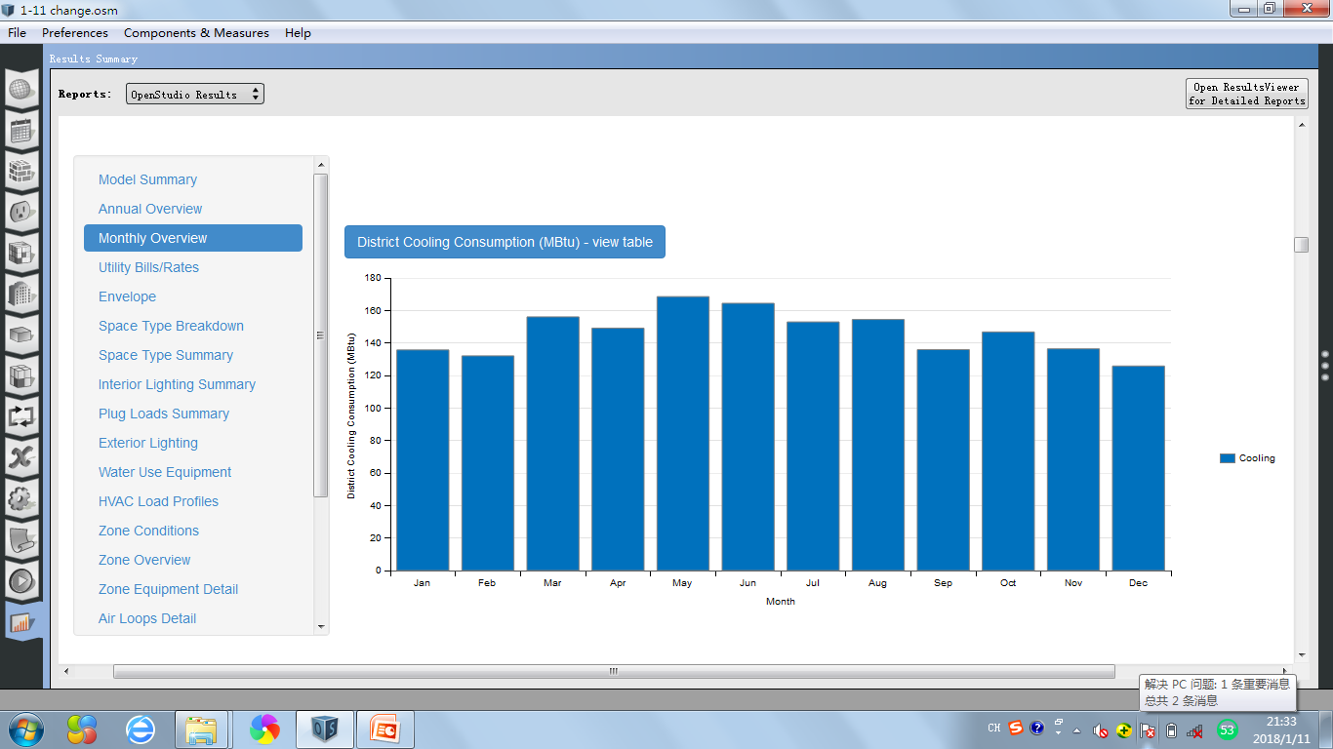
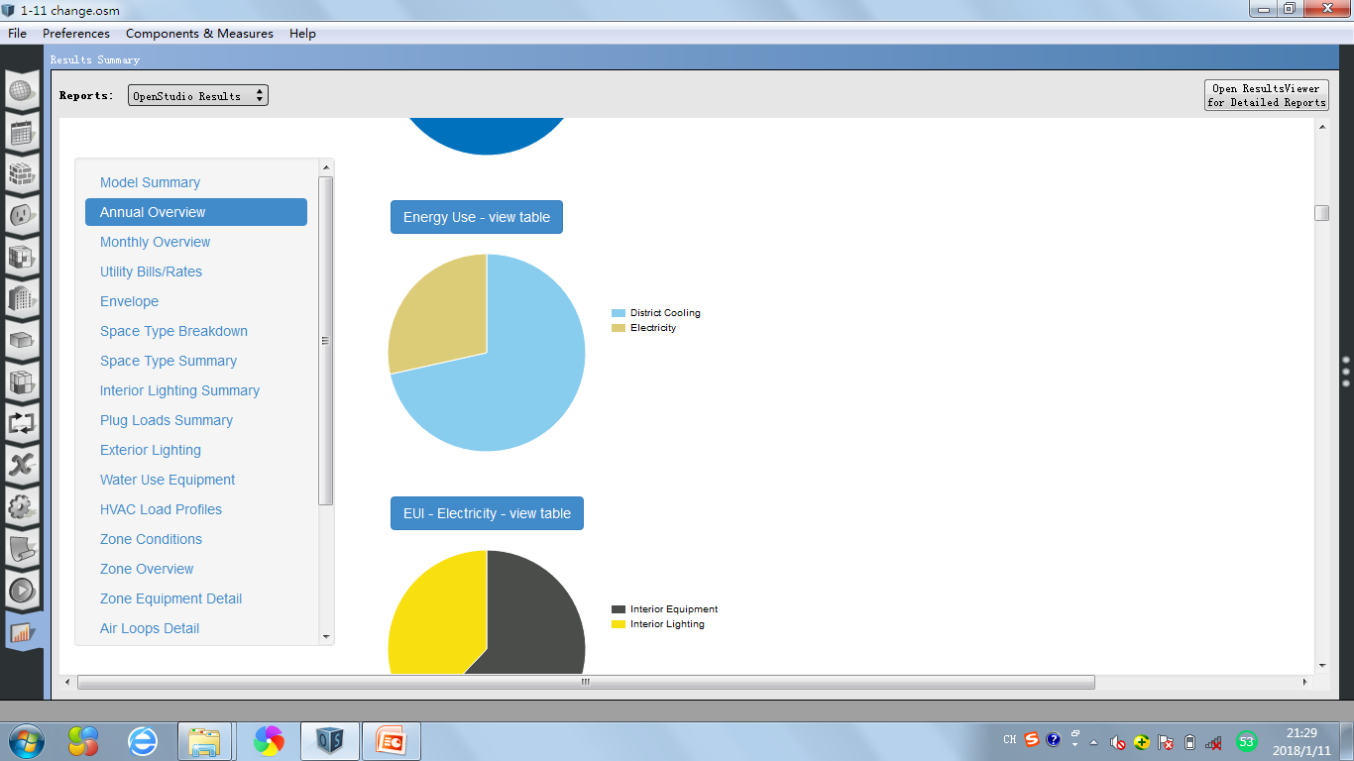
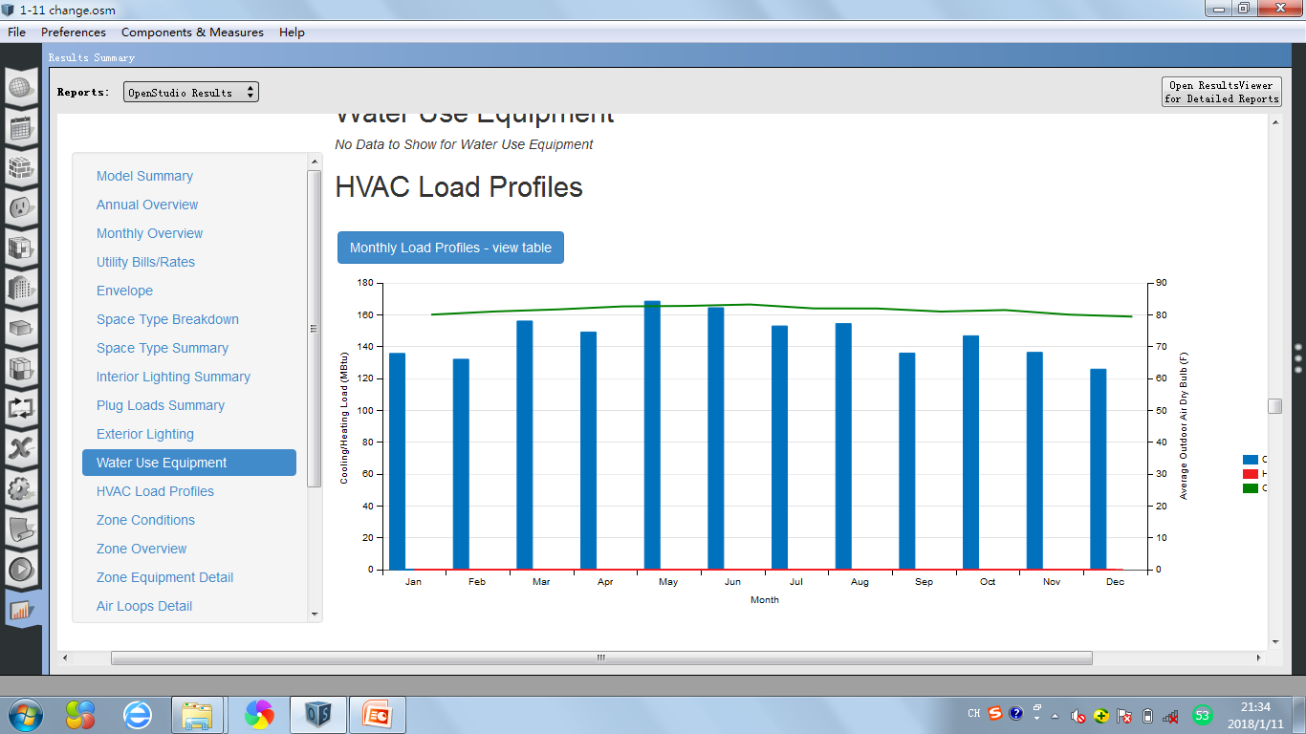
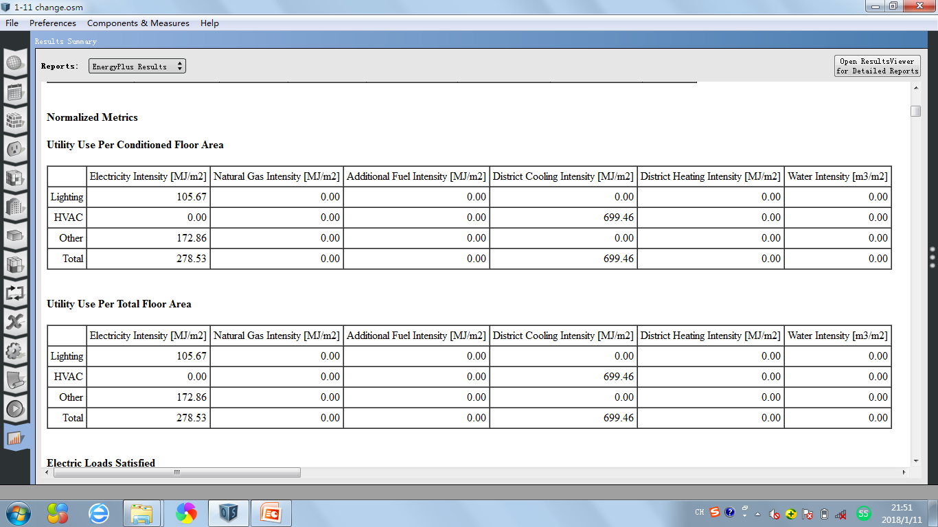
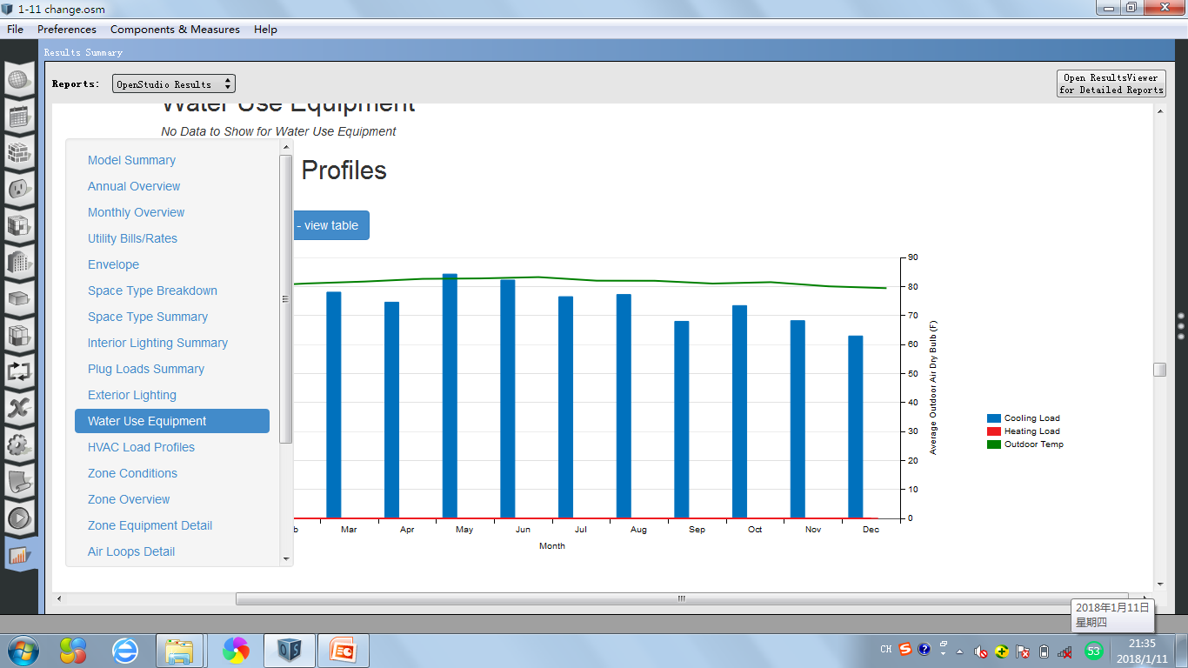
Singapore
0.3m
11%
0.4m
18%
1.8m
72%
The total energy of the building with wall insulation [31] in Singapore is 2593.63GJ. The energy use for heating is 0GJ, and 72% energy is used for cooling(1854.97GJ), 28% energy is used for electricity.
156
169
164
149
153
154
136
147
136
136
126
132
The table shows that a lot of energy is used for cooling through the whole year, with a medial value from 132MBtu to 169MBtu.
0.7m
28%
1.8m
72%
80
156
169
164
83
79
149
153
154
147
136
132
136
136
126

Slide 8
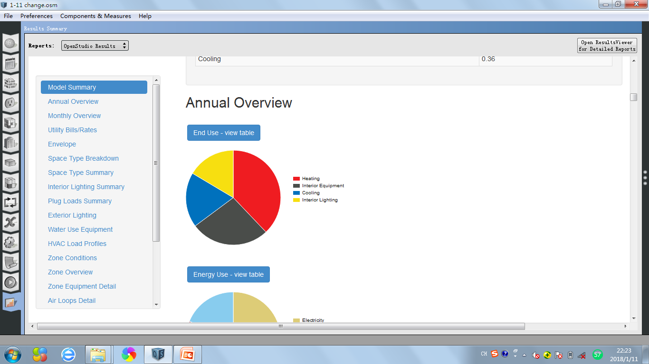
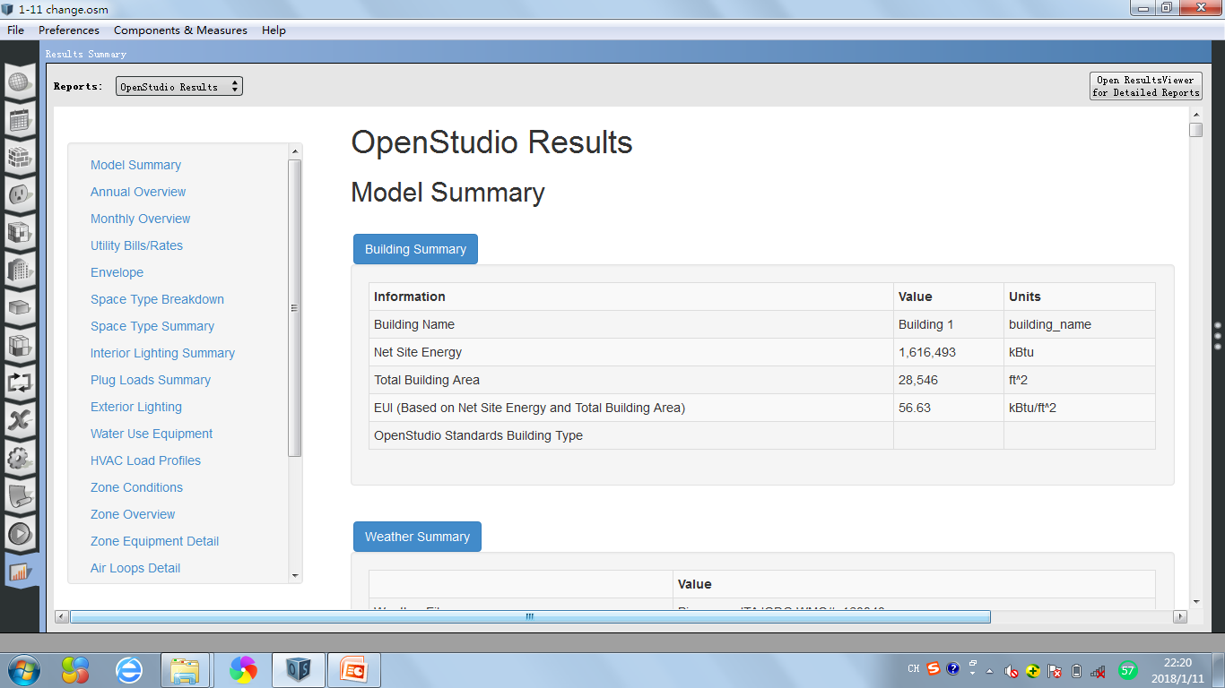

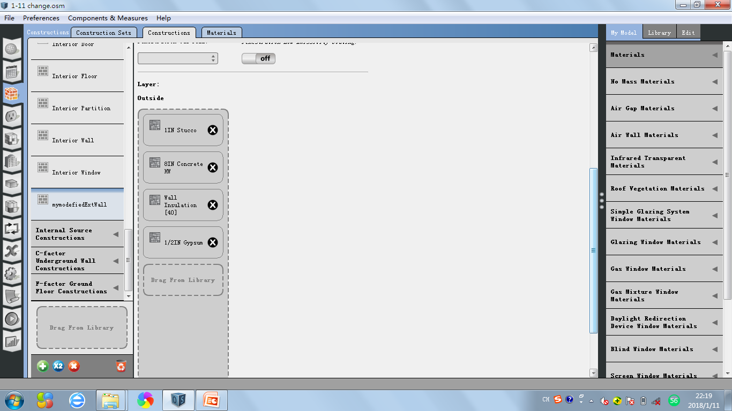
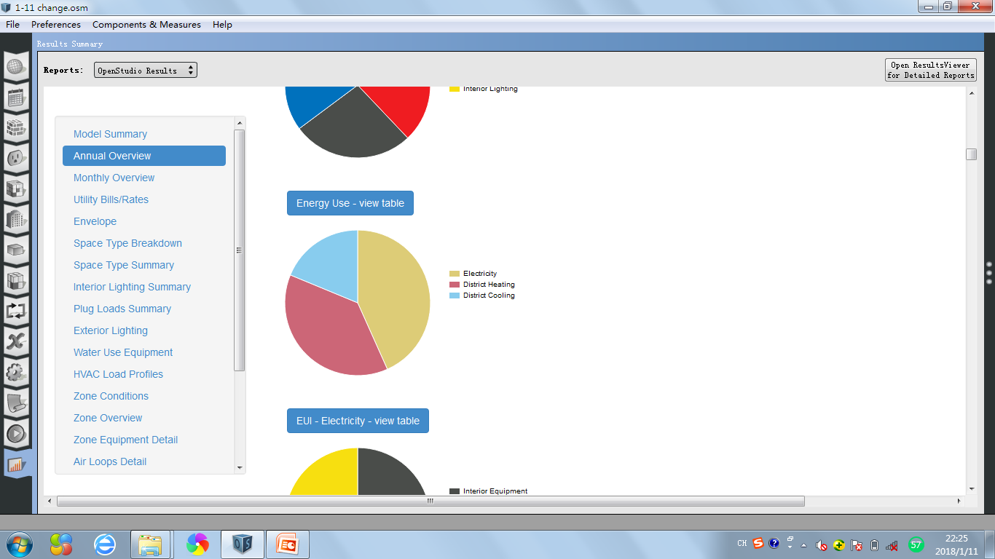

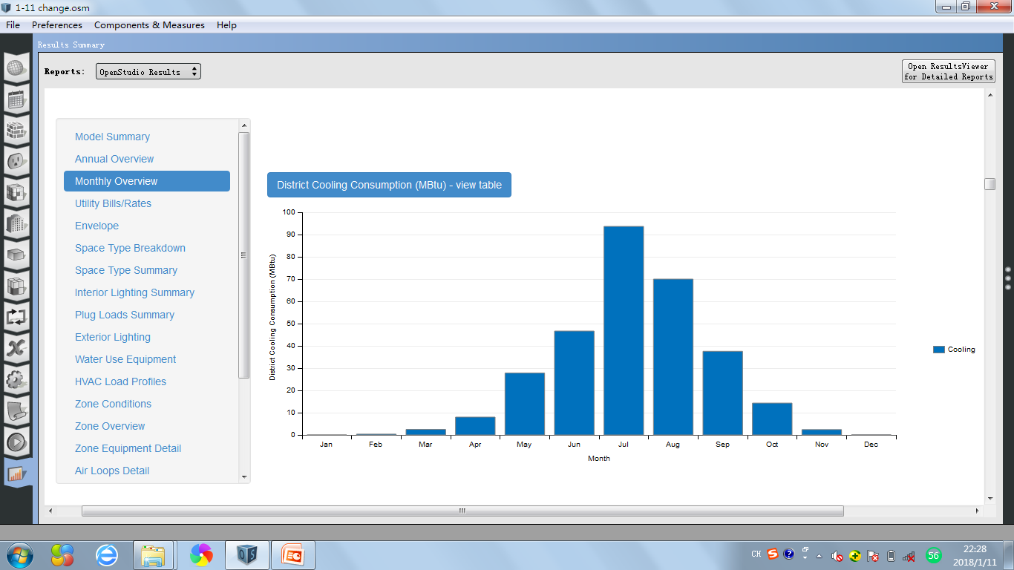
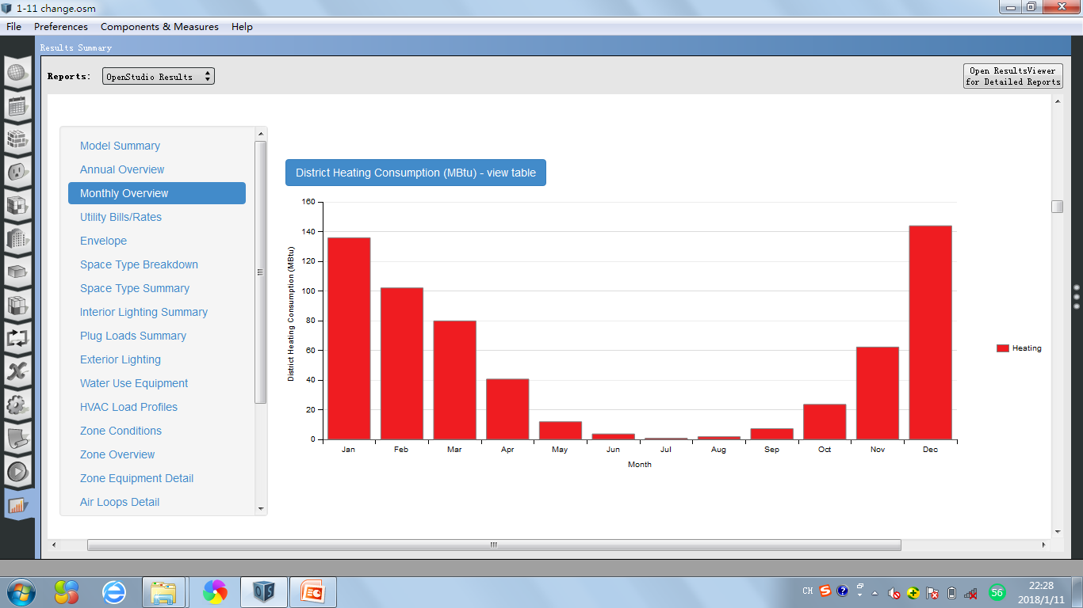
Piacenza-Italy
We changed the thickness of the wall insulation into 79.4mm. The construction is made of concrete; the exterior wall is composed by:
·25.3mm Stucco
·203.3mm Concrete HW
·79.4mm wall Insulation
·12.7mm Gypsum
266k
16%
266k
16%
613k
38%
303k
19%
613k
38%
303k
19%
434k
27%
303k
19%
700k
43%
The total energy of the building with wall insulation [40] in Piacenza is 1705.49GJ. The energy use for heating is 646.90GJ,which take the percentage of 38% in total energy, and 19% energy is used for cooling(319.92GJ), 43% energy is used for electricity.
613k
38%
94
136
144
70
102
47
80
38
62
28
41
8
14
12
24
0
0
2
2
0
4
1
2
7
In this bar-table, we can see that the value of the energy use for cooling increases from January to July, then starts to decrease in August, which means there is a peak in July with the value of 94 MBtu.
In this bar-table, we can see that the value of the energy use for heating decreases from January to July, then starts to increase from August, which means the energy which is used for heating has a highest value(144MBtu) in December and lowest in July(1MBtu).

Slide 9
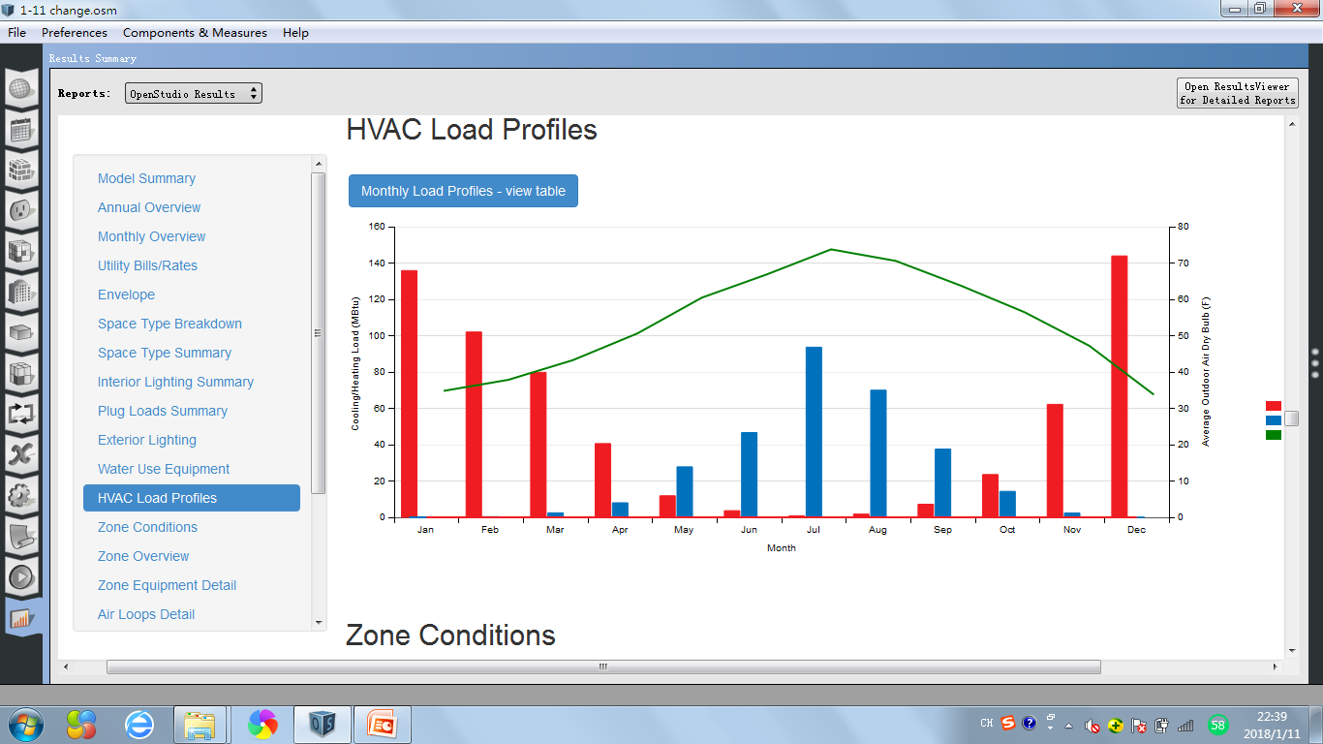
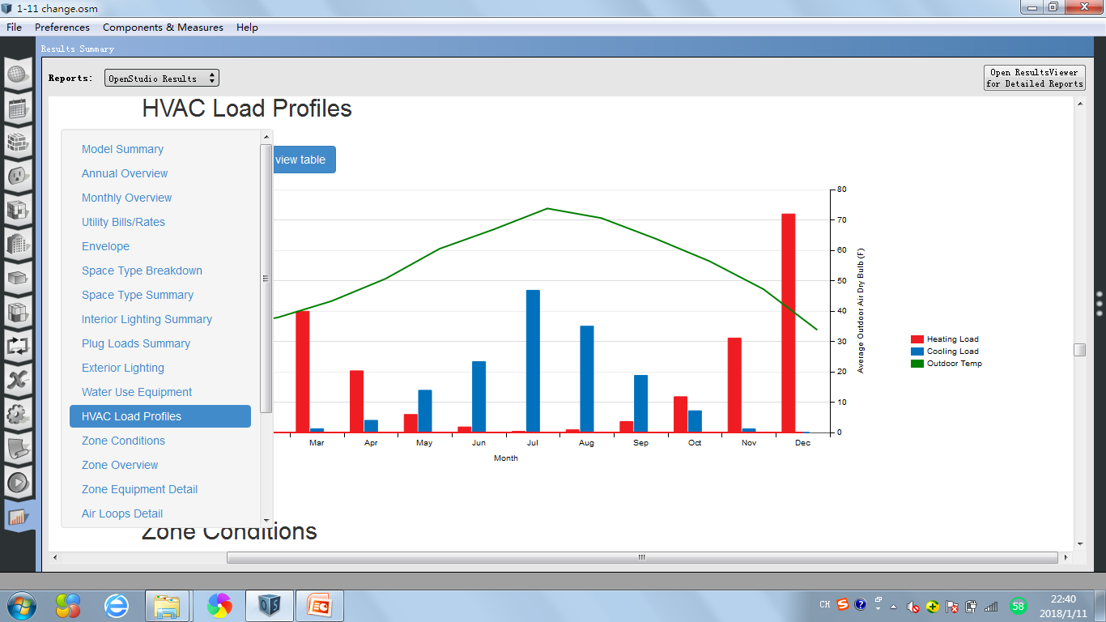

136
144
102
94
80
70
62
41
47
38
28
24
2
8
12
4
7
14
2
0
0
0
2
0

Slide 10
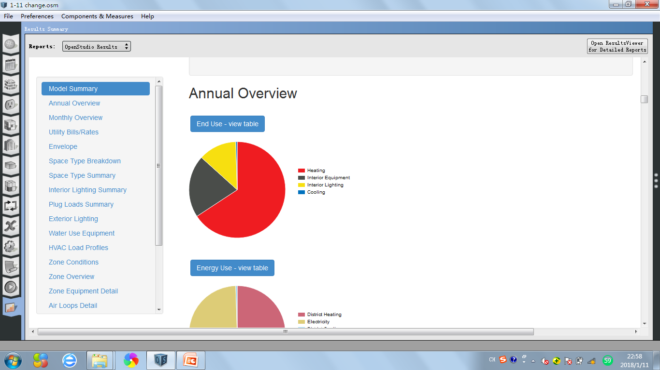
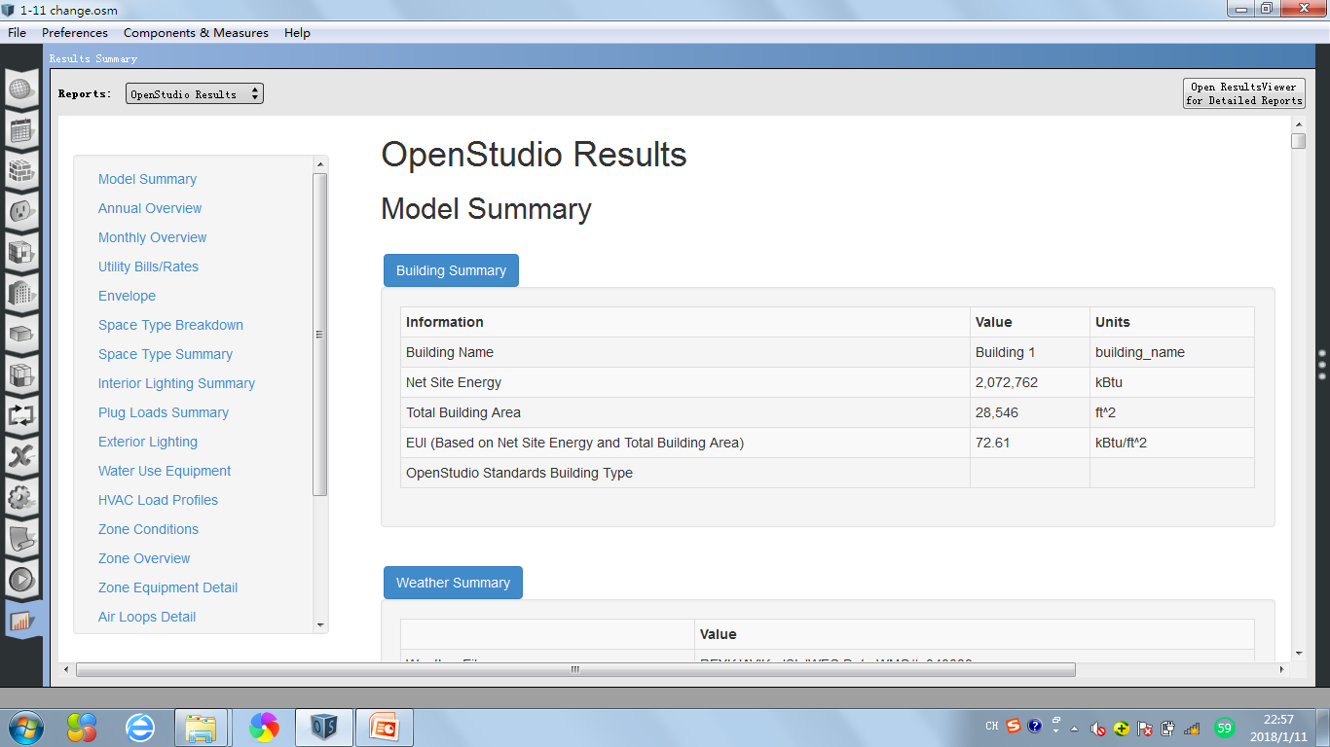

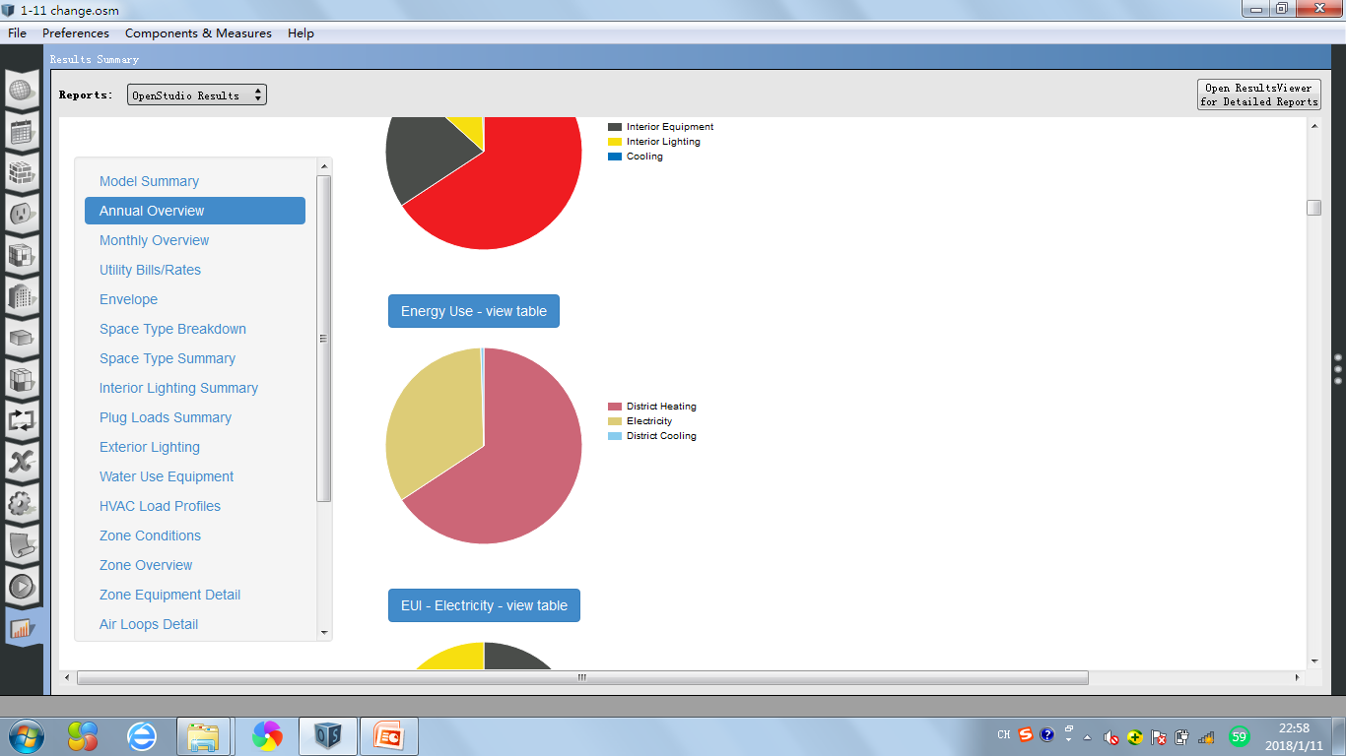
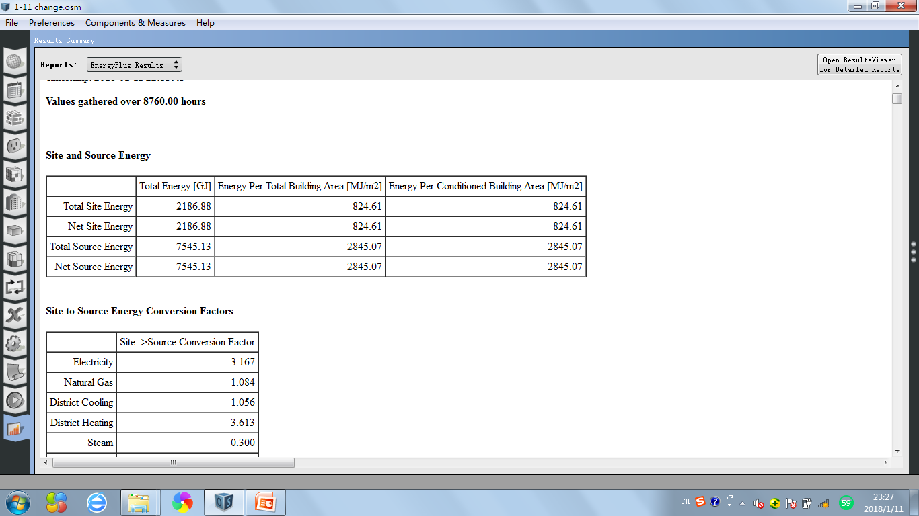
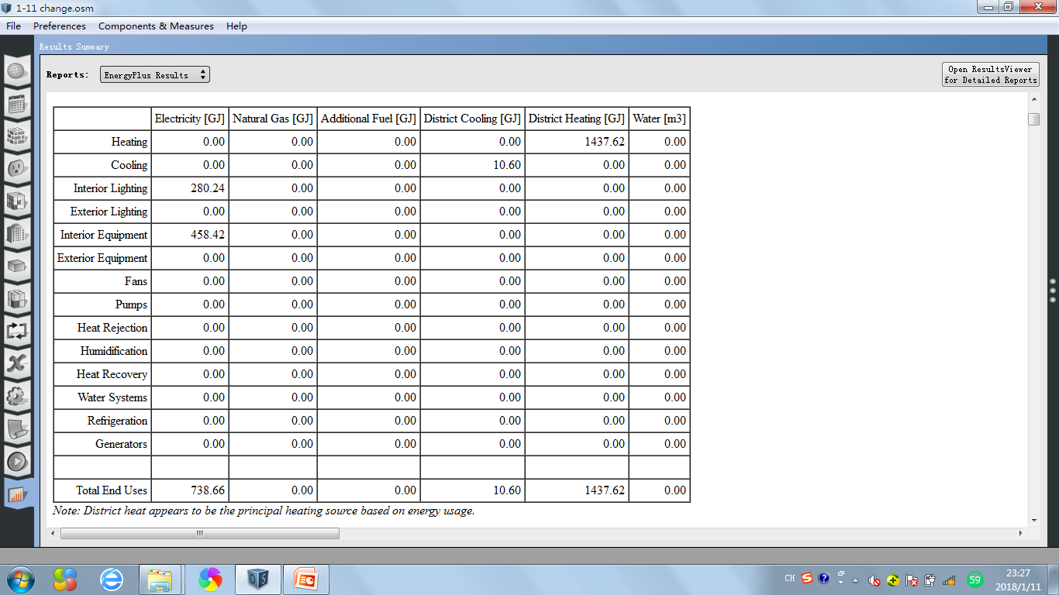
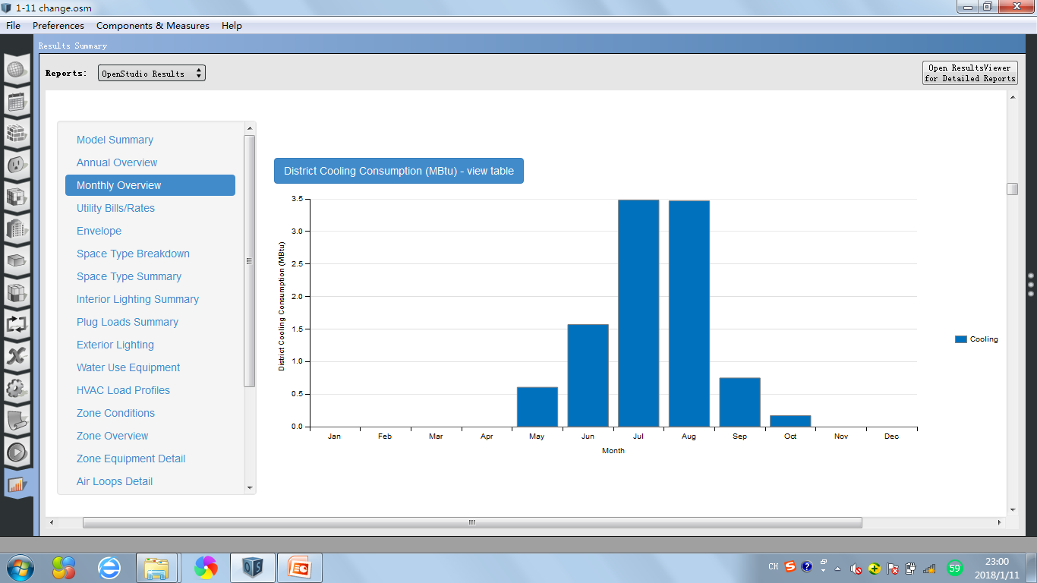

Reykjavik-Iceland
0.3m
13%
0.4m
21%
1.4m
66%
0.7m
34%
The total energy of the building with wall insulation [40] in Reykjavik, Iceland is 2186.88GJ. The energy use for heating is 1437.62GJ,which take the percentage of 66% in total energy, and only less than 1% energy is used for cooling(10.60GJ), 34% energy is used for electricity.
1.4m
66%
3.5
3.5
175
170
166
171
152
128
111
1.6
82
73
0.7
53
41
0.6
40
0.2
The table shows that the energy is only used from May to October with low value. The peak appears in July and August with 3.5MBtu value .
In this bar-table, we can see that the value of the energy use for heating exists all the yaer,which decreases from January to July, then starts to increase from August, which means the energy which is used for heating has a highest value(175MBtu) in January and lowest in August(40MBtu).

Slide 11



175
170
166
51
171
152
128
37
111
32
33
31
82
73
53
41
40
2
3
3

Slide 12









Singapore
0.3m
11%
0.4m
18%
1.8m
71%
The total energy of the building with wall insulation [40] in Singapore is 2547.34GJ. The energy use for heating is 0GJ, and 71% energy is used for cooling(1808.67GJ), 29% energy is used for electricity.
152
164
160
151
132
146
149
133
143
133
0.7m
29%
129
123
The table shows that a lot of energy is used for cooling through the whole year, with a medial value from 123MBtu to 160MBtu.
1.7m
71%
164
83
80
152
146
160
149
151
143
79
132
129
133
133
143

Slide 13
COMPARISON-Different City
VALUE OF DISTRICT COOLING(GJ)
 | CITY |  |  | off%
 | Piacenza（C1） | Iceland (C2) | Singapore (C3)
33.7 | 326.13 | 9.28 | 1854.97 | -97.0 | 468.8
79.4 | 319.92 | 10.60 | 1808.67 | -96.7 | 465.4
Thickness
of the wall insulation
(mm)
C2-C1
C3-C1
C1
C1
VALUE OF DISTRICT HEATING(GJ)
 | CITY |  |  | off%
 | Piacenza（C1） | Iceland (C2) | Singapore (C3)
33.7 | 680.17 | 1515.62 | 0.00 | 122.8 | -100.0
79.4 | 646.90 | 1437.62 | 0..00 | 122.2 | -100.0
Thickness
of the wall insulation
(mm)
C2-C1
C3-C1
C1
C1
In the case of 33.7mm wall insulation:
Comparing other two cities, the value of energy for cooling in Piacenza (326.13GJ)is higher than that in Reykjavik-Iceland(9.28GJ), but much lower than that in Singapore(1854.97GJ). And for heating, the value in Piacenza is double lower than that in Iceland, but much higher than that in Singapore, since the value in Singapore for heating is 0.
The case of 79.4mm wall insulation is the same situation as the one above.

Slide 14
COMPARISON-Different Thickness
33.7mm
79.4mm
When the thickness of wall insulation is double higher than before, the value of energy for cooling and heating decreases a little, only 1%. The energy for electricity nearly dose not change.
All three cities has the same situation.
Piacenza-Italy
309k
19%
303k
19%
700k
42%
700k
43%
645k
39%
613k
38%
0.7m
33%
0.7m
34%
Reykjavik-Iceland
1.4m
66%
1.4m
67%
Singapore
0.7m
28%
0.7m
29%
1.8m
72%
1.7m
71%

Slide 15

CONCLUSION
Climate has an important influence on the use of energy a lot. The energy for heating is used much more than that for cooling in low-temperature area, on the contrary, people in high-temperature area use more energy for cooling than that for heating. What’s more, the energy for electricity is not affected by weather.
The thickness of wall insulation affects the use of energy a little. When the wall insulation turns to be thicker, the use of energy decreases a little both for heating and cooling and dose not change for electricity.
In conclusion, when we design a building, we should consider that different climate has a different influence on the energy use. Also the construction of the wall should be taken into consideration, such as the thickness of wall insulation.
This project study help us to think more about the energetic requirement of architecture and create a more sustainable environment when we are working on building-design in the future.

